Slide 2
Overview

Slide 3
1. Timeliness of notification

Slide 4
What is the benchmark?

Slide 5
Is the benchmark being met?

Slide 6
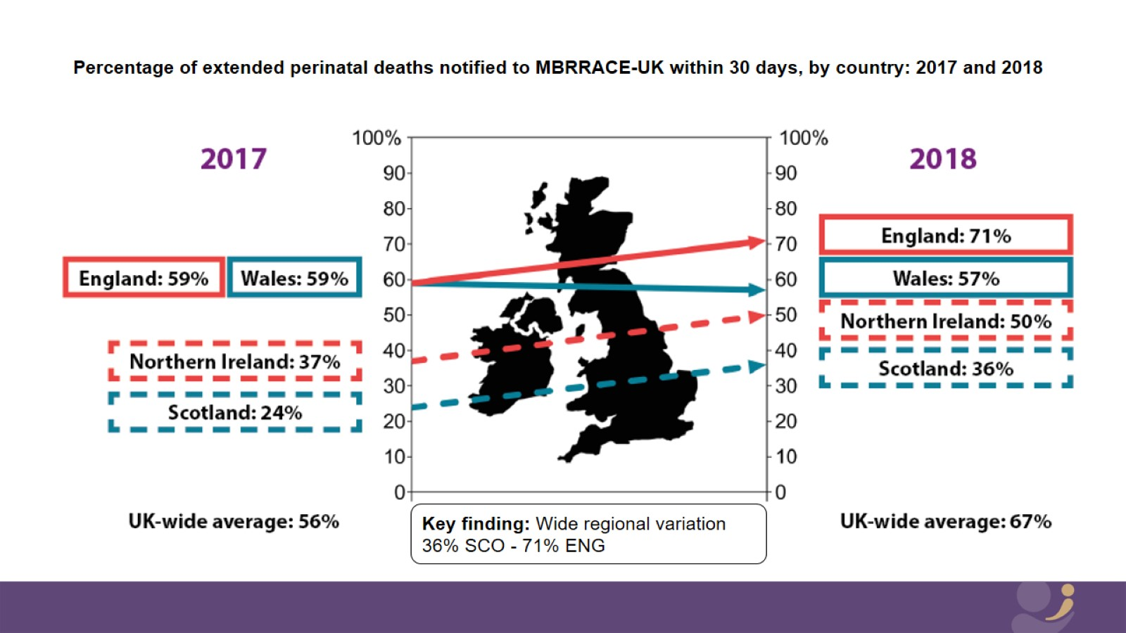

Slide 7
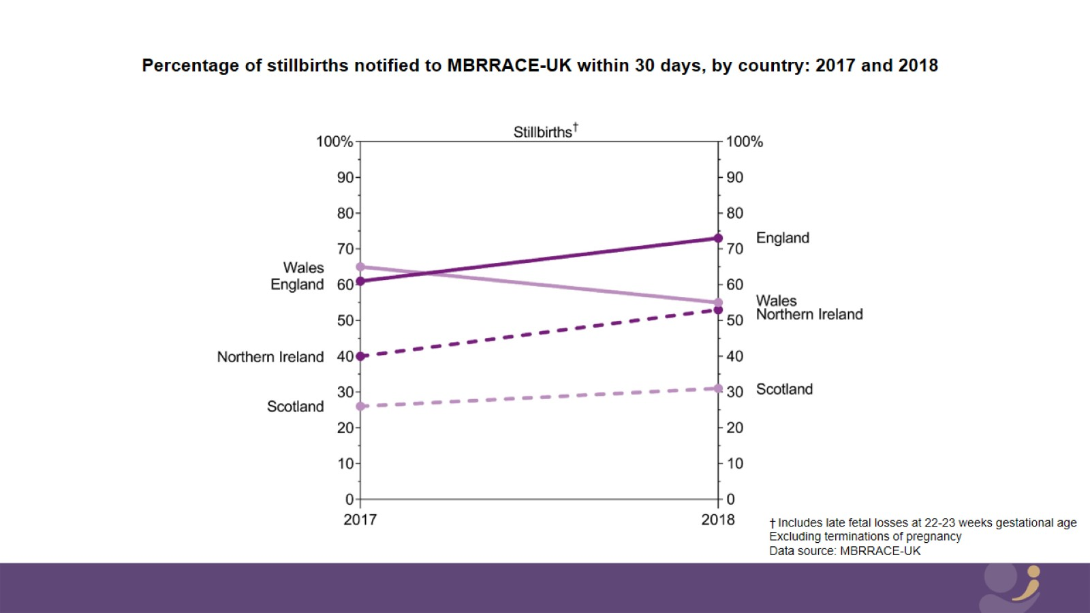

Slide 8
Timeliness of notification

Slide 11
Timeliness of notification

Slide 12
Implications

Slide 13
What about my Trust/HB?

Slide 14
PMRT driving improvements

Slide 15
2. Completeness of key data items

Slide 16
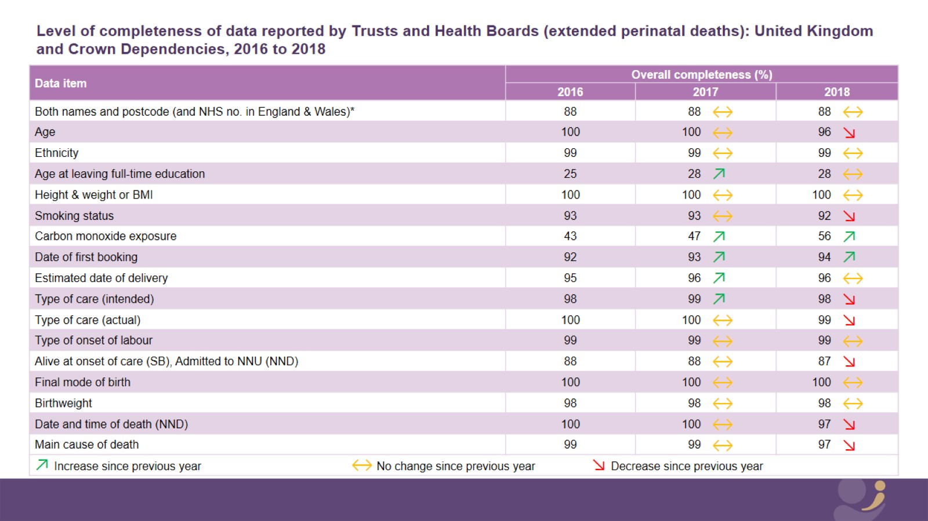
Level of completeness of data reported by Trusts and Health Boards (extended perinatal deaths): United Kingdom and Crown Dependencies, 2016 to 2018

Slide 18
Why is this important?

Slide 19
Why is this important?

Slide 20
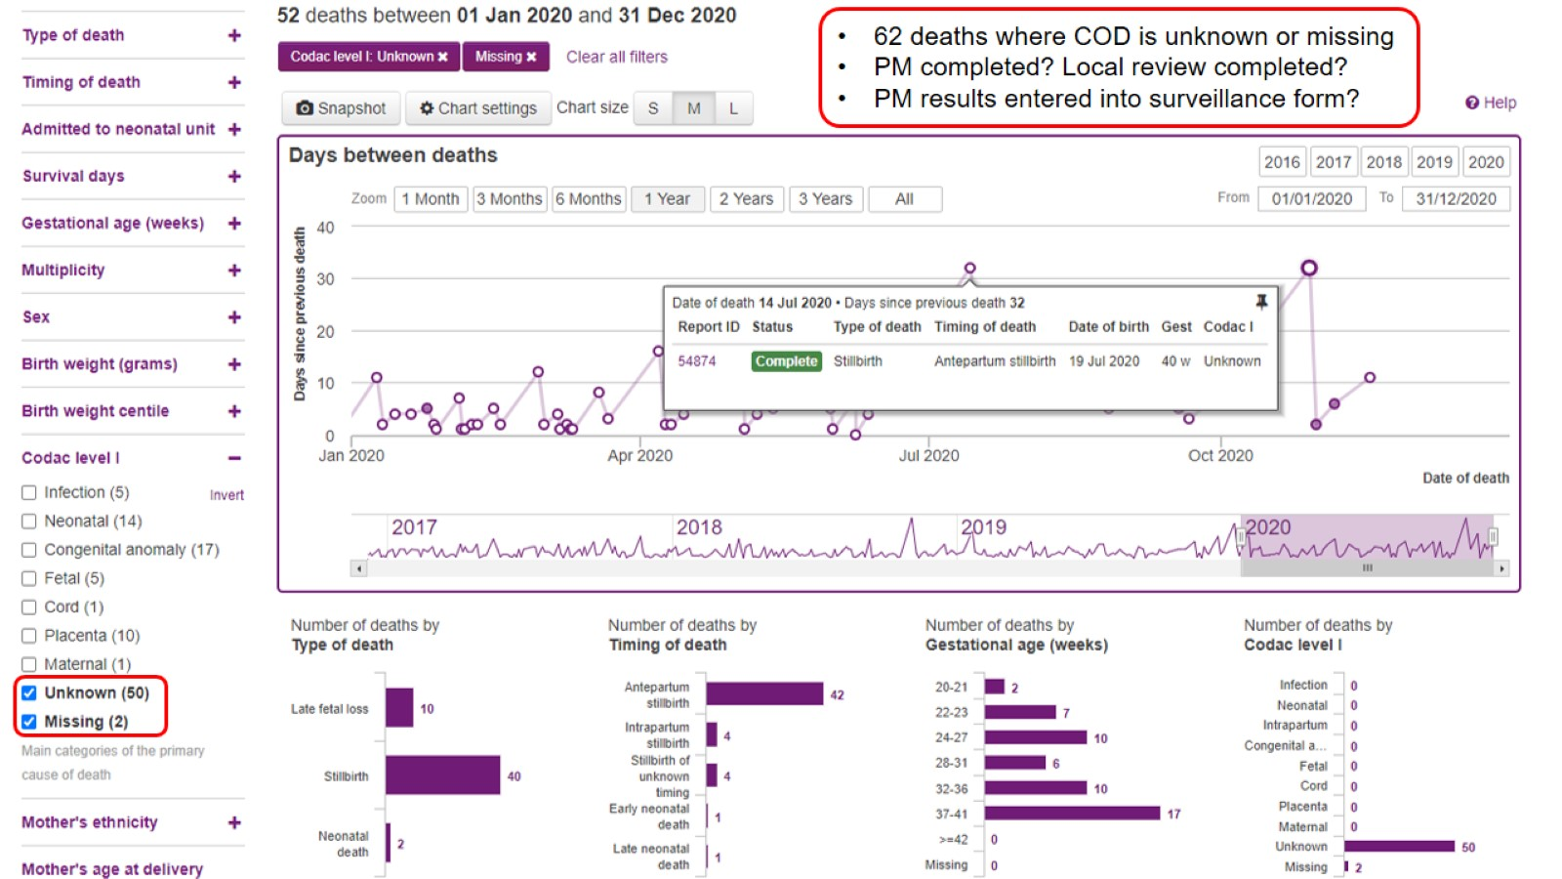

Slide 21
3. Recommendations

Slide 24
We want to help!

Slide 25
Thank you

Slide 26
Thank you

